Slide 1
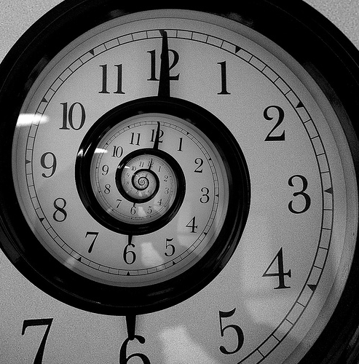
Going BACK in TIME to the PAST
The 3rd Conditional
What would you have done differently?
EFL SMARTblog http://efllecturer.blogspot.com/

Slide 2
Going BACK in TIME to the PAST
The 3rd Conditional
In this presentation you will...
Quickly check you know the 1st and 2nd conditionals page 3
Look at when and how to make the 3rd conditional page 5
Do sentence transformations making 3rd conditional sentences with picture prompts page 17
EFL SMARTblog http://efllecturer.blogspot.com/

Slide 3


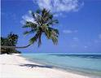
EFL SMARTblog http://efllecturer.blogspot.com/
How do we make make the 1st and 2nd conditionals?
When?
1st Conditional
If It is Sunny, I will go to the beach.
·today
·tomorrow
·next week
·on my next
holiday
If + PRESENT, + FUTURE
2nd Conditional
If It was sunny, I would go to the beach
If + PAST , + WOULD + Verb

Slide 4
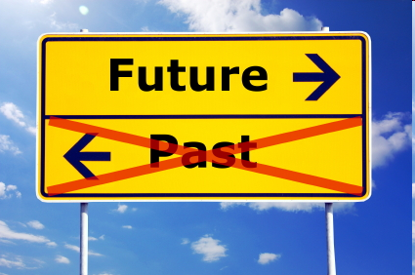

EFL SMARTblog http://efllecturer.blogspot.com/
How do we make make the 1st and 2nd conditionals?
When?
1st Conditional
If It is Sunny, I will go to the beach.
·today
·tomorrow
·next week
·on my next
holiday
If + PRESENT, + FUTURE
2nd Conditional
If It was sunny, I would go to the beach
If + PAST , + WOULD + Verb
With the 1st and 2nd conditionals we are imagining a time in the present or future
but what if we want to imagine changes in the past?

Slide 5

EFL SMARTblog http://efllecturer.blogspot.com/
When do we use the 3rd conditional?
Yesterday
When we want to imagine doing or changing something in the past
·yesterday
·last week
·last year
·when I was a child
3rd Conditional
EFL SMARTblog http://efllecturer.blogspot.com/

Slide 6
EFL SMARTblog http://efllecturer.blogspot.com/
How do we make the 3rd conditional?
Yesterday
·yesterday
·last week
·last year
·when I was a child
3rd Conditional

Slide 7
EFL SMARTblog http://efllecturer.blogspot.com/
How do we make the 3rd conditional?
Yesterday
If + PAST PERFECT ,
+ WOULD HAVE + PARTICIPLE
·yesterday
·last week
·last year
·when I was a child
3rd Conditional
If It had been sunny yesterday, I would have gone to the beach
If + PAST PERFECT , + WOULD HAVE + PARTICIPLE

Slide 8
EFL SMARTblog http://efllecturer.blogspot.com/
How do we make the 3rd conditional?
If...
+ HAD/N’T + PARTICIPLE, + WOULD/N’T have + PARTICIPLE
I
You
He
She
It
We
They
I
you
he
she
it
we
they
had /
hadn't
,
would /
wouldn't
have
been
come
found
done
seen
been
come
found
done
seen
·yesterday
·last week
·last year
·when I was a child
3rd Conditional
If + PAST PERFECT , + WOULD HAVE + PARTICIPLE

Slide 9
EFL SMARTblog http://efllecturer.blogspot.com/
Revise the 1st, 2nd and 3rd conditionals
When?
1st Conditional
If It is Sunny, I will go to the beach.
·today
·tomorrow
·next week
·on my next
holiday
If + PRESENT, + FUTURE
2nd Conditional
If It was sunny, I would go to the beach
If + PAST , + WOULD + Verb
·yesterday
·last week
·last year
·when I was a child
3rd Conditional
If It had been sunny yesterday, I would have gone to the beach
If + PAST PERFECT , + WOULD HAVE + PARTICIPLE

Slide 10
EFL SMARTblog http://efllecturer.blogspot.com/
When do we use the 3rd conditional?
Yesterday
When we want to imagine doing or changing something in the past
·yesterday
·last week
·last year
·when I was a child
3rd Conditional

Slide 11
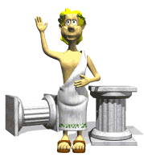
EFL SMARTblog http://efllecturer.blogspot.com/
Fill in the gaps to make the 3rd conditional
If I ___ ____ alive 2000 years ago,
I _____ ____ ____ a Roman
·yesterday
·last week
·last year
·when I was a child
3rd Conditional
If + PAST PERFECT , + WOULD HAVE + PARTICIPLE

Slide 12
EFL SMARTblog http://efllecturer.blogspot.com/
If I had been alive 2000 years ago,
I would have been a Roman
·yesterday
·last week
·last year
·when I was a child
3rd Conditional
If + PAST PERFECT , + WOULD HAVE + PARTICIPLE

Slide 13
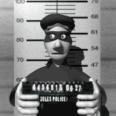
EFL SMARTblog http://efllecturer.blogspot.com/
Make a sentence in the 3rd conditional
If / thief / run faster /
police / not catch / him
·yesterday
·last week
·last year
·when I was a child
3rd Conditional
If + PAST PERFECT , + WOULD HAVE + PARTICIPLE

Slide 14
EFL SMARTblog http://efllecturer.blogspot.com/
If / thief / run faster /
police / not catch / him
If the thief had run faster, the police wouldn't have caught him.
·yesterday
·last week
·last year
·when I was a child
3rd Conditional
If + PAST PERFECT , + WOULD HAVE + PARTICIPLE

Slide 15
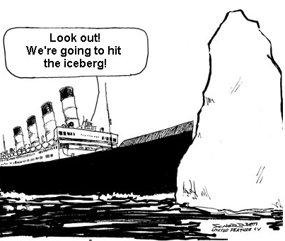
EFL SMARTblog http://efllecturer.blogspot.com/
If / Titanic / miss/
Iceberg / It / not sink
·yesterday
·last week
·last year
·when I was a child
3rd Conditional
If + PAST PERFECT , + WOULD HAVE + PARTICIPLE

Slide 16
EFL SMARTblog http://efllecturer.blogspot.com/
If / Titanic / miss/
Iceberg / It / not sink
If the Titanic had missed the iceberg, it wouldn't have sunk.
·yesterday
·last week
·last year
·when I was a child
3rd Conditional
If + PAST PERFECT , + WOULD HAVE + PARTICIPLE

Slide 17
Going BACK in TIME to the PAST
The 3rd Conditional
Practise
Sentence transformation
Make sentences for the pictures in the 3rd conditional
EFL SMARTblog http://efllecturer.blogspot.com/

Slide 18
The Titanic hit an iceberg and sank
EFL SMARTblog http://efllecturer.blogspot.com/

Slide 19
If the Titanic hadn’t hit an iceberg, it wouldn’t have sunk
EFL SMARTblog http://efllecturer.blogspot.com/

Slide 20
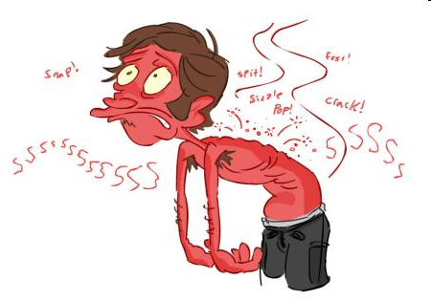
He stayed in the sun too long yesterday and got sunburnt
EFL SMARTblog http://efllecturer.blogspot.com/

Slide 21
If he hadn’t stayed in the sun too long yesterday, he wouldn’t have got sunburnt
EFL SMARTblog http://efllecturer.blogspot.com/

Slide 22
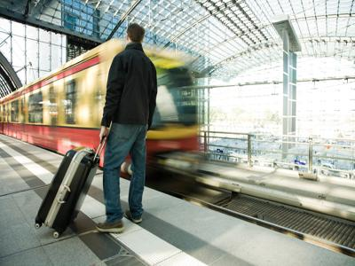
He arrived late and missed the train
EFL SMARTblog http://efllecturer.blogspot.com/

Slide 23
If he hadn’t arrived late, he wouldn’t have missed the train
EFL SMARTblog http://efllecturer.blogspot.com/

Slide 24
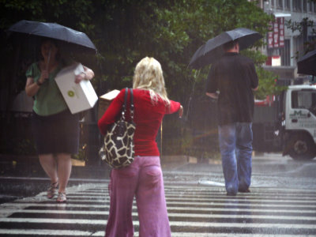
She forgot her umbrella and got wet
EFL SMARTblog http://efllecturer.blogspot.com/

Slide 25
If she hadn’t forgotten her umbrella, she wouldn’t have got wet
EFL SMARTblog http://efllecturer.blogspot.com/

Slide 26

He was angry so he punched his laptop
EFL SMARTblog http://efllecturer.blogspot.com/

Slide 27
If he hadn’t been angry, he wouldn’t have punched his laptop
EFL SMARTblog http://efllecturer.blogspot.com/

Slide 28

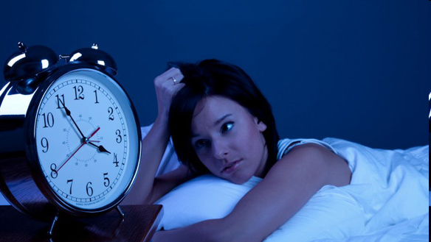
She drank so much coffee yesterday, she couldn’t sleep last night
EFL SMARTblog http://efllecturer.blogspot.com/

Slide 29
If she hadn’t drunk so much coffee yesterday, she would have been able to sleep last night
EFL SMARTblog http://efllecturer.blogspot.com/

Slide 30




She got a virus on her laptop because she didn’t install an antivirus
EFL SMARTblog http://efllecturer.blogspot.com/

Slide 31
If she had installed an antivirus on her laptop, she wouldn’t have got a virus
EFL SMARTblog http://efllecturer.blogspot.com/

Slide 32
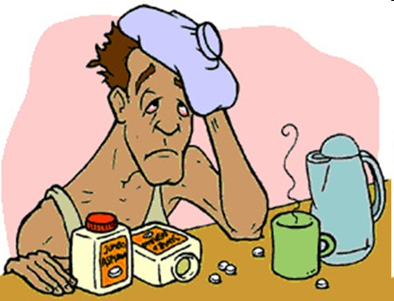
He drank so much last night, he had a hangover when he woke up
EFL SMARTblog http://efllecturer.blogspot.com/

Slide 33
If he hadn’t drunk so much last night, he wouldn’t have had a hangover when he woke up
EFL SMARTblog http://efllecturer.blogspot.com/

Slide 34
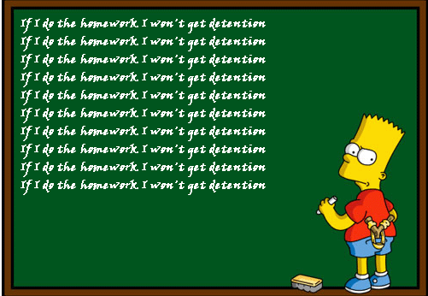
Bart didn’t do his homework so he had to stay late in school yesterday
EFL SMARTblog http://efllecturer.blogspot.com/

Slide 35
If Bart had done the homework, he wouldn’t have had to stay late in school yesterday
EFL SMARTblog http://efllecturer.blogspot.com/

Slide 36
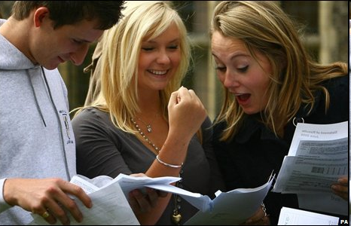
They worked so hard they passed their exams
EFL SMARTblog http://efllecturer.blogspot.com/

Slide 37
If they hadn’t worked so hard, they wouldn’t have passed their exams
EFL SMARTblog http://efllecturer.blogspot.com/

Slide 38
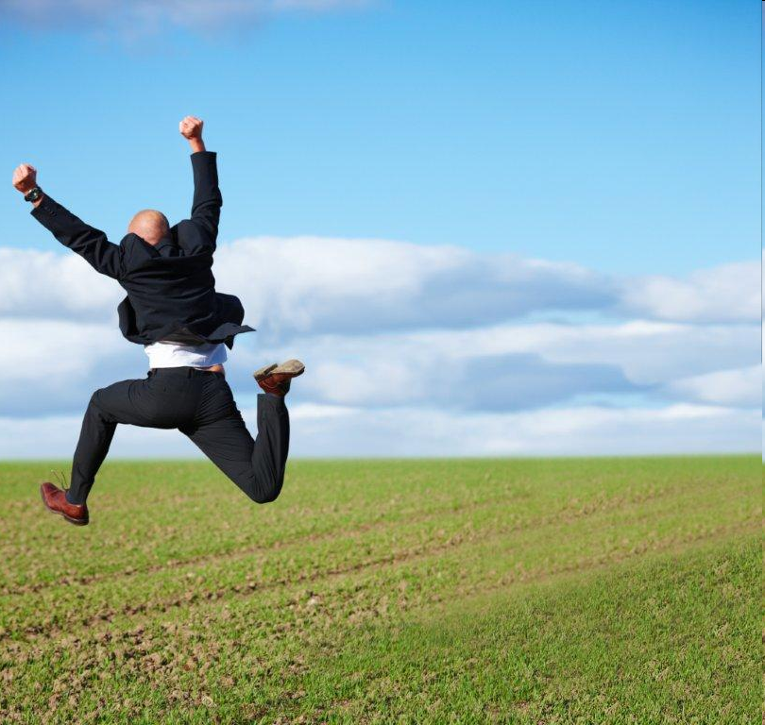
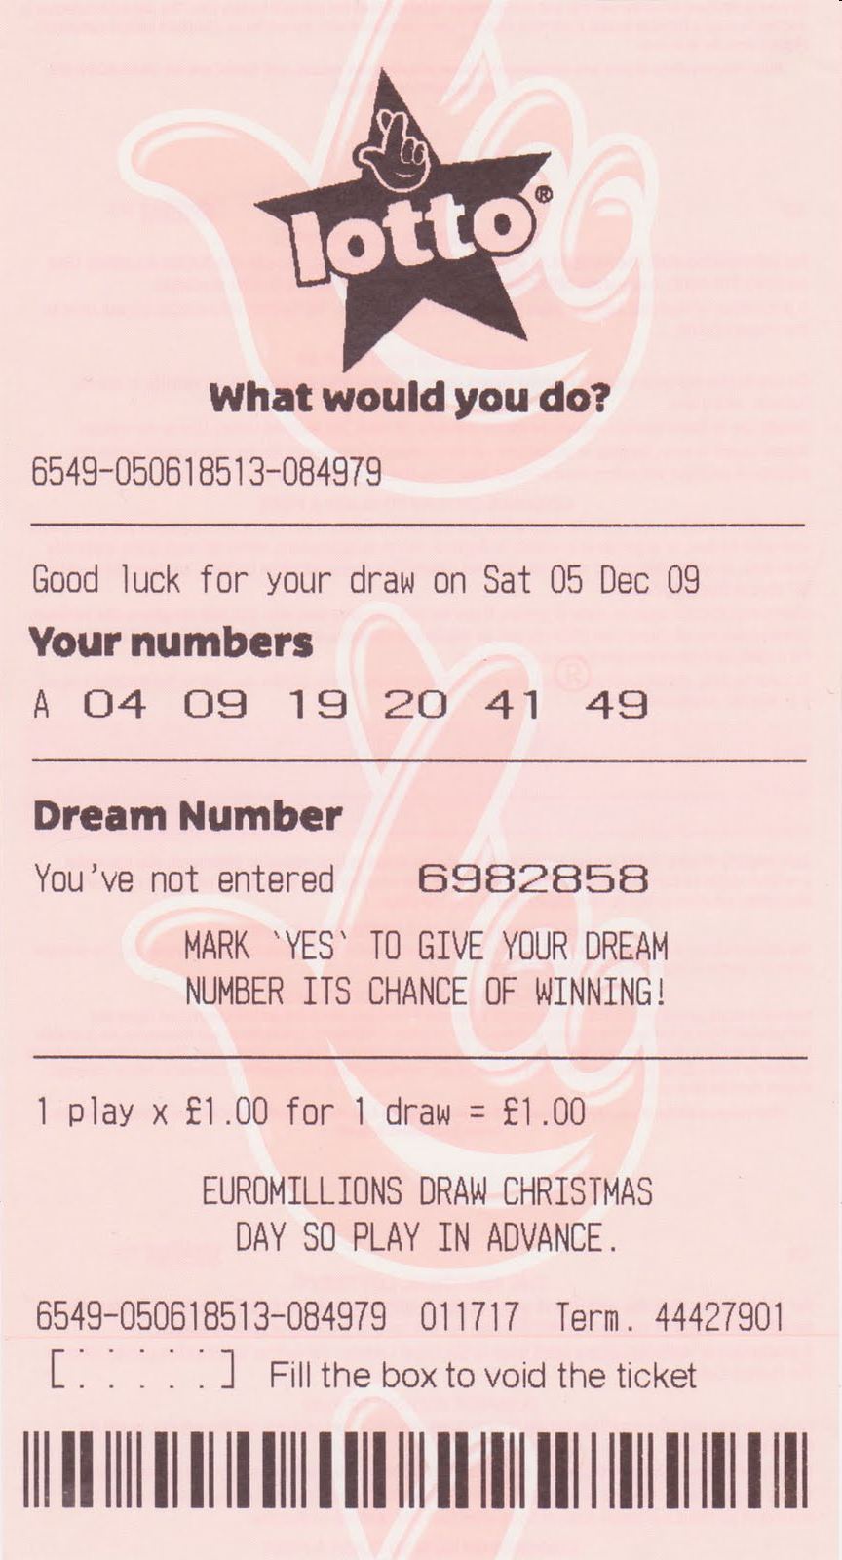
He bought a lottery ticket and won
EFL SMARTblog http://efllecturer.blogspot.com/

Slide 39
If he hadn’t bought a lottery ticket, he wouldn’t have won
EFL SMARTblog http://efllecturer.blogspot.com/

Slide 40
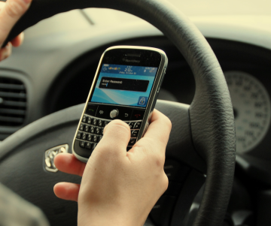
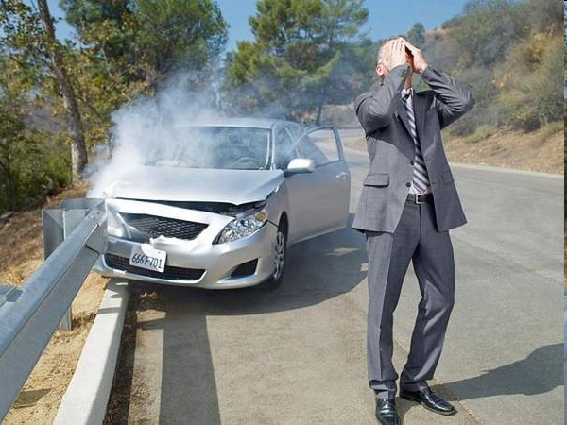
He was texting on the phone and had an accident
EFL SMARTblog http://efllecturer.blogspot.com/

Slide 41
If he hadn’t been texting on the phone, he wouldn’t have had an accident
EFL SMARTblog http://efllecturer.blogspot.com/

Slide 42
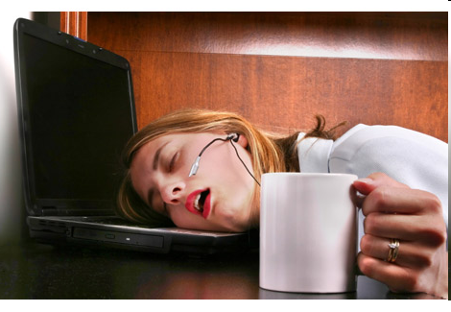
She was working so hard that she fell asleep

Slide 43
If she hadn’t been working so hard, she wouldn’t have fallen asleep
EFL SMARTblog http://efllecturer.blogspot.com/

Slide 44
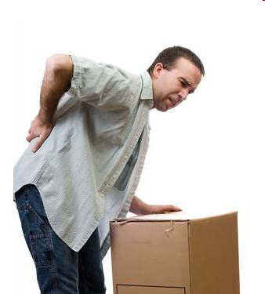
He was lifting the box when he hurt his back
EFL SMARTblog http://efllecturer.blogspot.com/

Slide 45
If he hadn’t been lifting the box, he wouldn’t have hurt his back
EFL SMARTblog http://efllecturer.blogspot.com/

Slide 46
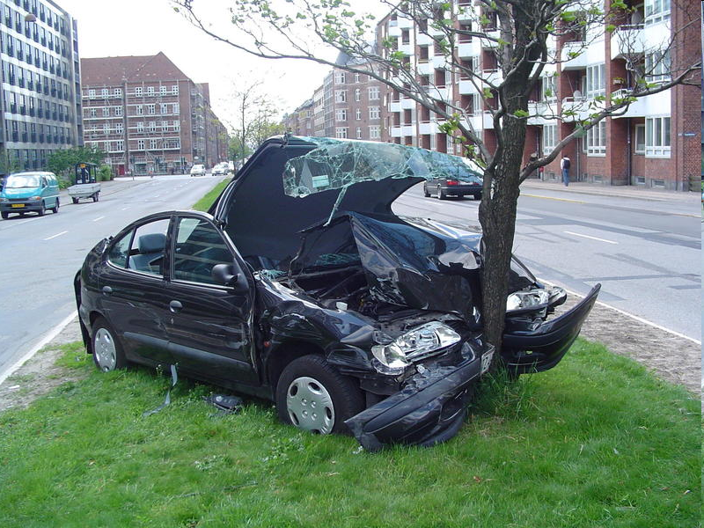
He wasn’t looking where he was going and he hit the tree
EFL SMARTblog http://efllecturer.blogspot.com/

Slide 47
If he had been looking where he was going, he wouldn’t have hit the tree
EFL SMARTblog http://efllecturer.blogspot.com/

Slide 48
EFL SMARTblog http://efllecturer.blogspot.com/
If...
PAST
PERFECT
had /
hadn't
WOULD HAVE + PARTICIPLE
I
You
He
She
It
We
They
I
you
he
she
it
we
they
,
would /
wouldn't
have
been
come
found
done
seen
been
come
found
done
seen
·yesterday
·last week
·last year
·when I was a child
3rd Conditional
If + PAST PERFECT , + WOULD HAVE + PARTICIPLE

